Slide 1
EARTH GUARD
TEAM MEMBERS
Hargun Singh - 2210990360
Harinder Singh Dhanoa- 2210990361
Harshit Behal - 2210990386
Himanshu Shukla-2210990408
Under the supervision of
Shagun Sharma
Chitkara University, Punjab

Slide 2
Introduction
Objectives
The primary objective of our Average Temperature Prediction Model is to accurately forecast yearly average temperatures. This model utilizes historical weather data and advanced machine learning algorithms to deliver precise and reliable long-term temperature predictions. The goal is to aid individuals, businesses, and various sectors in making informed decisions based on expected annual weather patterns.
Background
Predicting long-term weather trends has always been essential for strategic planning and risk management. Our model is designed to harness this capability, drawing on an extensive dataset of historical weather data and employing cutting-edge machine learning techniques.
The development of this model involves:
Collecting and pre-processing comprehensive historical weather data.
Identifying patterns and trends within this data over extended periods.
Utilizing machine learning algorithms to train the model.

Slide 3
Significance
Understanding temperature patterns is crucial for various reasons. It helps -
farmers plan their crops
guides urban planners in designing climate-resilient cities
enables policymakers to address issues related to climate change.
Moreover, as young citizens, gaining insights into environmental data empowers us to make informed decisions about our planet's future.

Slide 4
PROBLEM STATEMENT
Predicting yearly average temperatures is a complex yet critical task that can significantly impact various aspects of human life, from individual daily activities to large-scale industrial operations.
To address these challenges, we propose the development of an Average Temperature Prediction Model that aims to:
Accurately Predict Yearly Average Temperatures
Enhance Decision-Making
Strengthen Risk Management

Slide 5
Methods, Tools & Technologies
The code is written in Python, a popular programming language for data analysis and machine learning. It utilizes several libraries and frameworks:
Pandas: We used it for data manipulation and analysis, especially for handling tabular data.
Matplotlib and Seaborn: We used these for Plotting graphs which helps in deciding next steps.
Plotly Express: A high-level visualization library that creates interactive plots, including histograms and line charts, with ease.
Scikit-learn: A machine learning library in Python that provides simple and efficient tools for data mining and data analysis.
TensorFlow: An open-source machine learning framework developed by Google for building and training neural networks, including Recurrent Neural Networks (RNNs) used in the code.
These tools enable data preprocessing, exploratory data analysis, model development, training, evaluation, and visualization, facilitating a comprehensive analysis of temperature data in India.

Slide 6
ML Algorithms
The machine learning algorithm used in the code is a Recurrent Neural Network (RNN) which belongs to Artificial Neural Networking(ANN). RNNs are a type of neural network designed to handle sequential data, such as time series data, where the order of observations is important. In this context, the RNN model is trained on historical temperature data to learn patterns and relationships, enabling it to make predictions about future temperature trends.

Slide 7
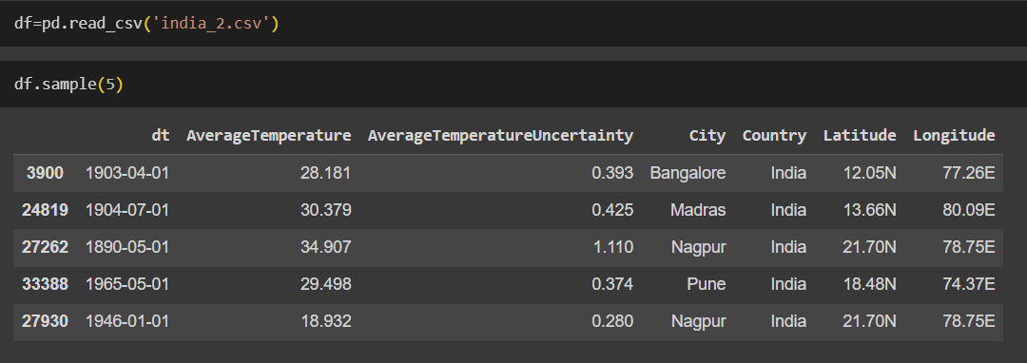
OUR DATASET
The dataset contains the following columns:
1. dt: This column represents the date in the format YYYY-MM-DD, indicating when the temperature measurement was taken.
2. Average Temperature: This column contains the average temperature recorded at the specified date and location.
3. Average Temperature Uncertainty: This column provides the uncertainty associated with the average temperature measurement.
4. City: This column denotes the name of the city where the temperature measurement was recorded.
5. Country: This column specifies the country to which the city belongs, in this case, all entries are from India.
6. Latitude: This column indicates the latitude coordinates of the city's location.
7. Longitude: This column specifies the longitude coordinates of the city's location.
Each row in the dataset represents a temperature measurement recorded at a specific date, location (city), and corresponding uncertainty.

Slide 8
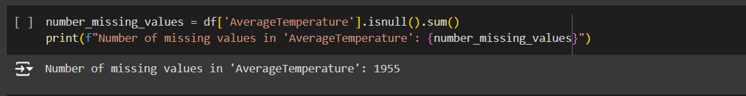
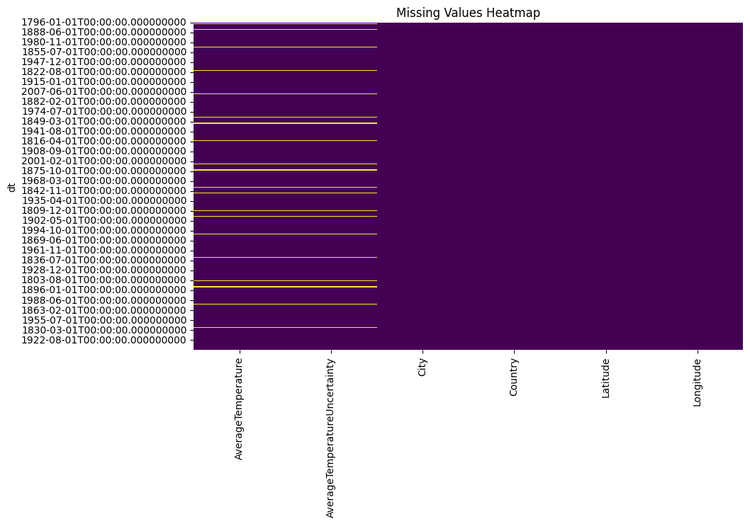
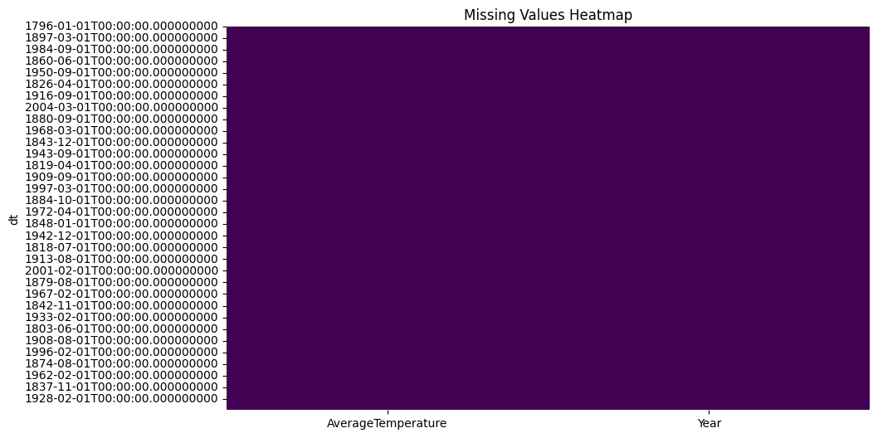
GRAPHS

Slide 9
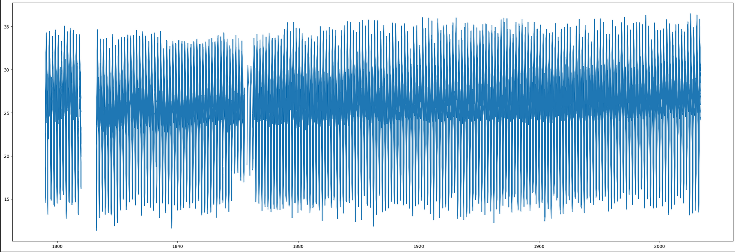
This graph shows the fluctuation of average temperature throughout the years 1796-2023.

Slide 10
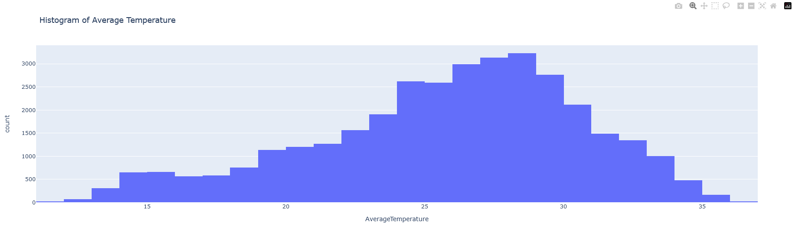
This shows the sum of average temperature in their respective range

Slide 11
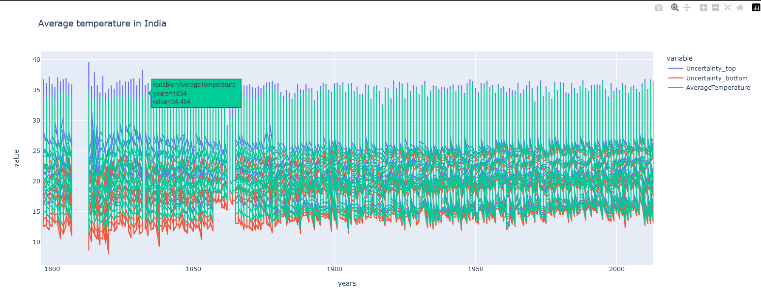
Uncertainity in Graph

Slide 12
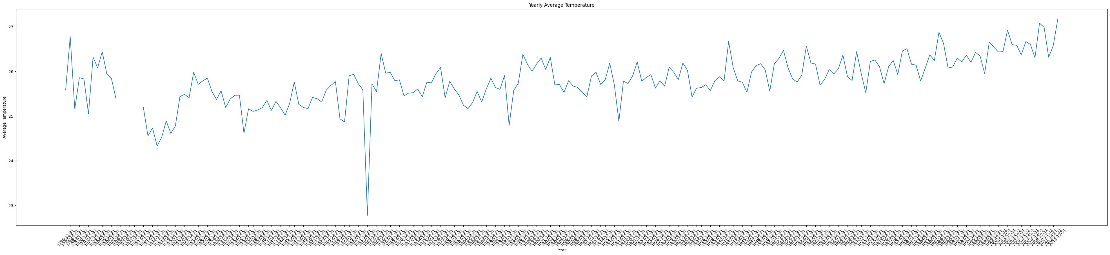
Mean of Average temperature in a single year

Slide 13
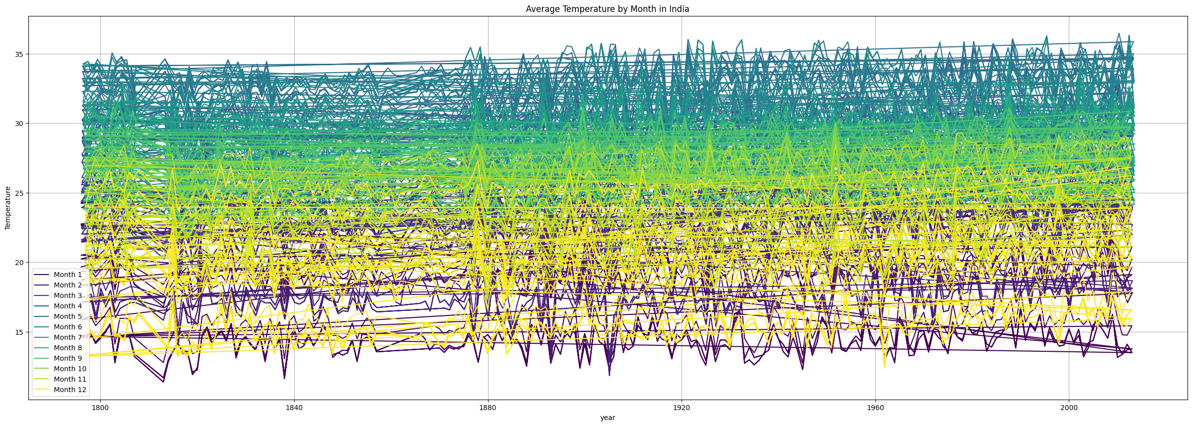
Temperature variation throughout the 12 months

Slide 14
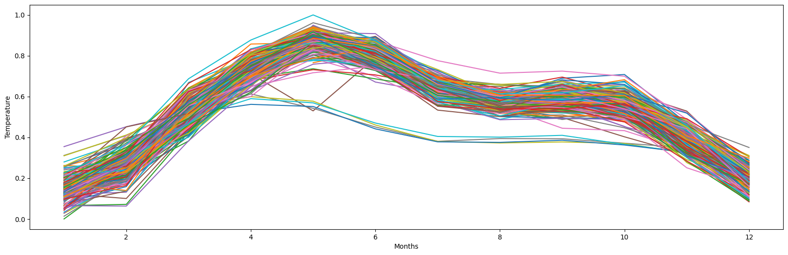
Average Temperature is high in middle of the year

Slide 15
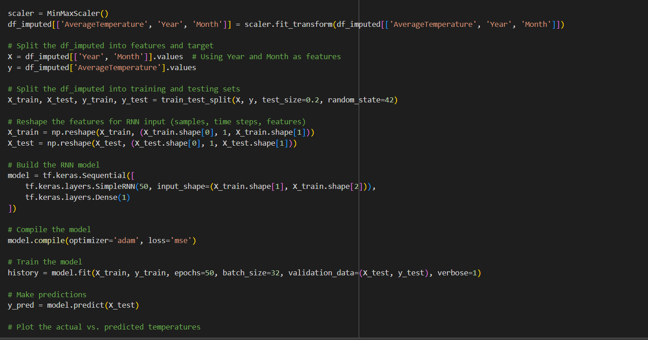
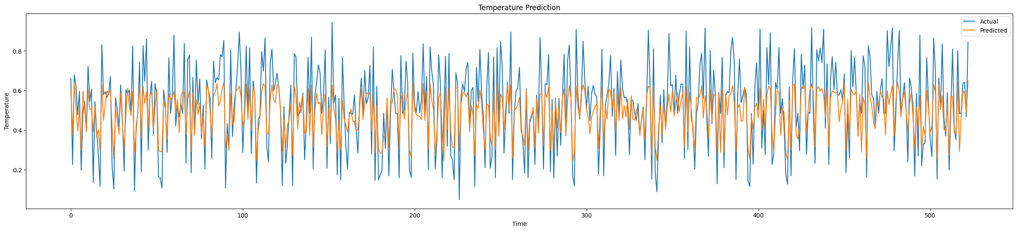
Result

Slide 16
Conclusion
Our analysis has provided valuable insights into temperature trends in India through comprehensive exploratory analysis, data imputation, and model development using Recurrent Neural Networks (RNNs).
We have identified significant trends, seasonal variations, and predictive capabilities in historical temperature data, contributing to informed decision-making across various sectors.
The understanding gained from our analysis is crucial for devising climate-resilient strategies in sectors such as agriculture, public health, and urban planning.
By leveraging advanced data analysis techniques and predictive modeling, we aim to inform stakeholders and policymakers about temperature dynamics and facilitate sustainable development efforts.
Continued research and collaboration are essential to address the evolving impacts of climate change and ensure a resilient and sustainable future for India and beyond.

Slide 17
References
We have taken reference from :
https://www.kaggle.com/datasets/berkeleyearth/climate-change-earth-surface-temperature-data
This dataset offers annual surface temperature data for nearly all cities spanning the years 1796 to 2022. The dataset is provided in two formats, allowing flexibility in data analysis and visualization: tidy format and wide format.

Slide 18

Thank You

